Slide 1

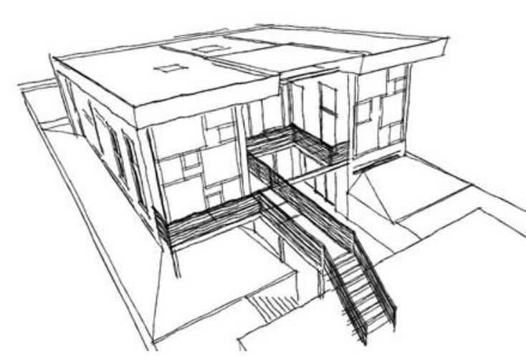
Open Source Home Energy Reduction System (OSHERS)
- Project Proposal -
Sponsor: Res Communis
Advisor: Dr. Douglas V. Hall
Students:
Nam Nguyen
Hai Nguyen
Hieu Nguyen
Michael Stoltz
Michael White

Slide 2
Executive Summary
Designed to be a fully functional, resource independent system that incorporates energy saving designs and reducing the impact on the environment.
User can benefit from:
A sensor network that is linked to a central server
Motion sensors to monitor motion in a given space or room
Analyze power usage by capturing real-time power data
Real-time monitoring of water level and water flow via sensors
Control outputs via server, such as blinds or composting toilet
Open-source and low cost system

Slide 3
Introduction
Sensor nodes provide a real-time acquisition of data and wirelessly transmits that data to the server.
Interfacing with four sensors (ambient light, humidity, temperature, and motion sensing) in a node.
Open-source, flexible and expandable.
Low component cost, easy-to-use, low energy required.

Slide 4
Scope
In this proposal, we will describe the features of our solution and how it will meet the needs of the Res Communis project.
We will then outline some risks and dependencies and how we will address those risks.
Finally, we will outline the per room cost and overall project cost.

Slide 5
Proposal Format
System Overview
Overview of the JeeNode platform & Sensors
Overview of the Outputs
Communication Protocol
Documentation
Risks and Dependencies
Predictable Cost

Slide 6
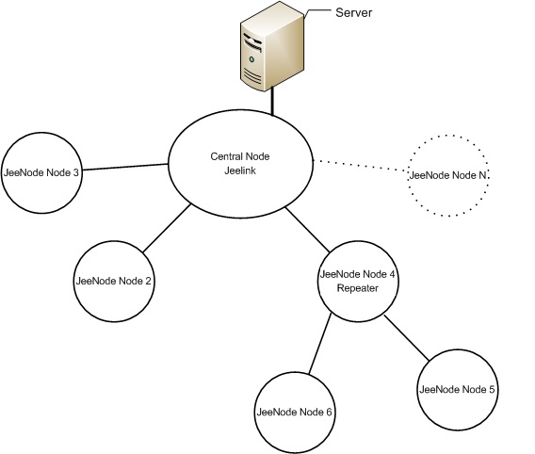
System Overview
Node diagram of a wireless sensor network

Slide 7
Overview of The JeeNode-based Platform and Sensors

Slide 8
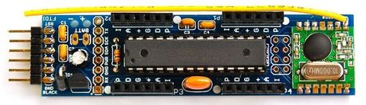
JeeNode
A JeeNode board comes with:
ATMega328 microcontroller
An RF module for radio communication
Compatible with Arduino IDE and libraries.
Enable both digital and analog multiple sensor acquisition.

Slide 9
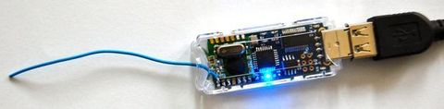
JeeLink
A pre-assembled JeeNode with additional:
Onboard memory
A USB port
Plugged to the server to receive data from JeeNode
Communicate with the server through USB

Slide 10
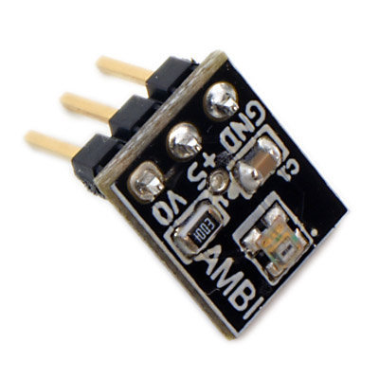
Ambient Light Sensor
A light-sensitive electronic component that can sense environment’s light level.
Output voltage value corresponding to the light level.
Use the AMBI light sensor from Modern Device Company.

Slide 11
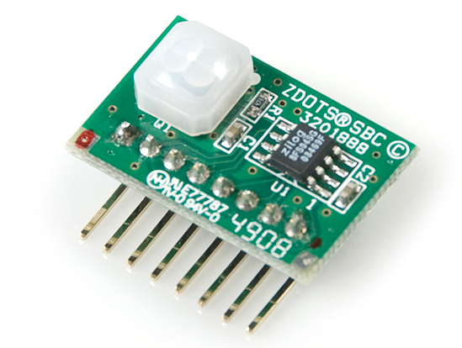
Motion Sensor
Use PIR (Passive Infrared) sensor. Detecting motion by using IR signal.
Use the Zilog's ePIR sensor. Provides superior sensitivity and stability.
Interface with JeeNode through serial communication.

Slide 12
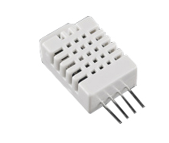
Humidity/Temperature Sensor
Used for sensing the temp. and humidity of the environment.
Use the DHT-22 sensor which combining two sensors in one package.
Low-cost and easy to use by using an open-source library.

Slide 13
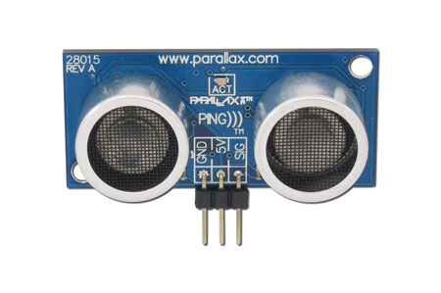
Water-level Sensor
Use ultrasonic sensor.
It’s used for measuring distance by using ultrasonic wave.
Use the PING)))™ ultrasonic sensor from Parallax.
Low –cost, easy to use, and accurate.

Slide 14
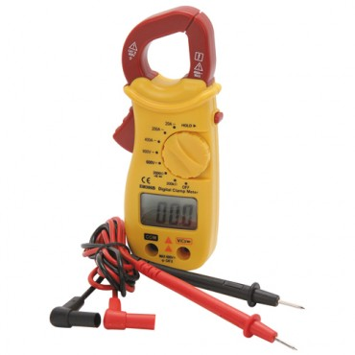
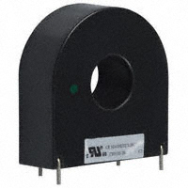
Power Monitoring
Measuring current flowing in the service conductors using a clamp on current transformer (CT).
Capable of measuring up to 400 amps.
The output will be connected to the JeeNode to allow scaling and power calculation.

Slide 15
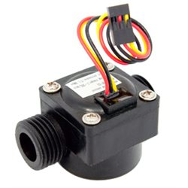
Water Flow Sensor
Use Hall-effect sensor. Rolls when water flows through it.
Send pulses to JeeNode at a frequency of 0 to 450Hz.
These pulses will be counted to find out the amount of water flowing through.

Slide 16
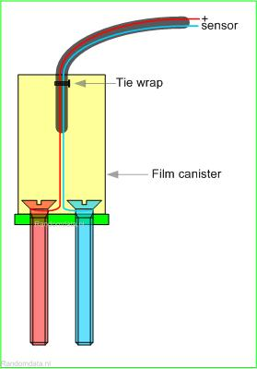
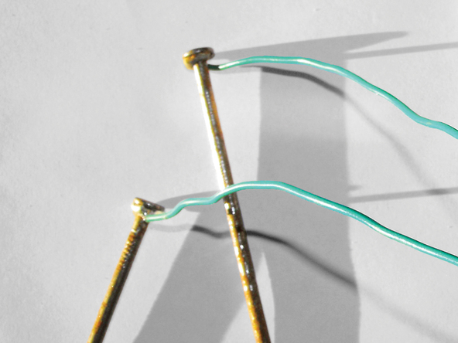
Soil Moisture Sensor
Use a two-stake sensor attached to analog ports on JeeNode.
These sensors can be two galvanized nails or screws separated by a given distance.
Calculate the soil moisture based on the resistance.

Slide 17
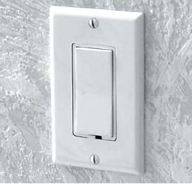
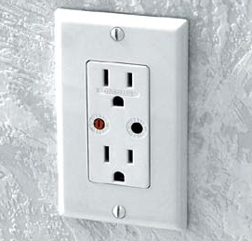
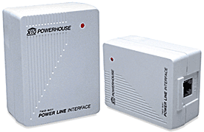
Overview of Outputs - Dimming Lights and Outlet -
Use X10, Insteon or Z-Wave products.
Protocols are documented and Arduino libraries exist for X10 devices.
JeeNode interface to power line interface.
Interest is high. Cost is coming down while reliability is going up.

Slide 18
Overview of Outputs - Blinds and Motors-
Blinds:
Controlled by a sensor node.
Can set min and max point to open and close the blind
Composting toilet motor:
A DC motor will be connected to the composting toilet’s exterior crank
Controlled the motor by an attached JeeNode
Water pump/motor:
Use a motor with JeeNode controller
Operate based on data from the soil moisture sensor

Slide 19
Communication Protocol
When a node wants to communicate with another node, the data could be packaged in the following manner:
Frame | Route | Action | Data | End of package
Route | Path of the transmission
Action | What the sender is going to do
Data | Data to send to the destination
End of package | Termination the transmission

Slide 20
Communication Protocol
Example: Getting temperature from node ID = 3
Central Node
ID =1
ID=2
ID=3
Node 1 send map | Route |  |  | Action | Data |  |  | EOP
 | 0x02 | 0x02 | 0x03 | M | 0x02 | 0x02 | 0x01 | 0xFF
Node 1 send request | Route |  |  | Action | Data | EOP
 | 0x02 | 0x02 | 0x03 | R | T | 0xFF
Node 3 send data | Route |  |  | Action | Data |  | EOP
 | 0x02 | 0x02 | 0x01 | D | T | Value (1 byte) | 0xFF

Slide 21
Documentation
Will include all theory, assembly, alternatives and modifications of the project.
Links to all online resources will also be included.
Open-source documentation.
Invites revisions, refinements and further support from the open-source community

Slide 22
Risks and Dependencies
Motor for Composting Toilet: Automation is not recommended by manufacturer.
Minimum and maximum torque/speed for the composter’s tines is unknown.
Blind motors: The size, weight and action of the blind is undefined. This increases the complexity of choosing an appropriate motor and it's method of control.
The number of sensor nodes needed could change. An increase cost is possible.

Slide 23
Risks and Dependencies
The ultrasonic sensor may suffer from water splash damage and humidity buildup.
Water-flow sensor selected has durability concerns. The inlet size of 1/2” may not suffice for measuring a household. An alternative sensor is available for $80-$300.
Assembly materials and sensor enclosures will be determined later. The cost for both in this document is only an estimation.

Slide 24
Predicted Cost
Project Component Cost
Part Name | Part Number | Manufacturing | Vendor | Price per Part
JeeNode Wireless PCB | JeeNode V5 Kit | JeeLabs | www.moderndevice.com | $22.50
DHT22 - Humidity/Temp Sensor | SEN-10167 | Aosong Electronics Co.,Ltd | www.sparkfun.com | $8.96
Ambient Light Sensor | AMBI Light Sensor | Sharp | www.moderndevice.com | $4.47
Motion PIR Sensor | SEN-09587 | Zilog | www.sparkfun.com | $10.76
Ultrasonic (Water Level Sensor) | SEN136B5B | Seeed Studio | www.robotshop.com | $15.00
Water Flow Sensor | POW110D3B | Seeed Studio | www.robotshop.com | $9.50
SuperSocket - Wall Receptacle Module | SR227 | X-10 | www.x10.com | $15.99
Decorator Dimmer Switch | x10_ws12a | X-10 | http://www.x10.com/products/x10_ws12a.htm | $19.99

Slide 25
Predicted Cost
Sensor Node Cost
Sensor Node Package | Part Number | Manufacturing | Vendor | Price/ Part
JeeNode Wireless PCB | JeeNode V5 Kit | JeeLabs | www.moderndevice.com | 22.50
DHT22 - Humidity/Temp Sensor | SEN-10167 | Aosong Electronics Co.,Ltd | www.sparkfun.com | $8.96
Ambient Light Sensor | AMBI Light Sensor | Sharp | www.moderndevice.com | $4.47
Motion PIR Sensor | SEN-09587 | Zilog | www.sparkfun.com | $10.76
 |  | Total Price Per Sensor Node: |  | $46.69
Estimate Deployment Cost
Deployment Costs | Estimated Nodes | Total Cost
Estimated cost of sensor node deployment | 16 | $747.04

Slide 26
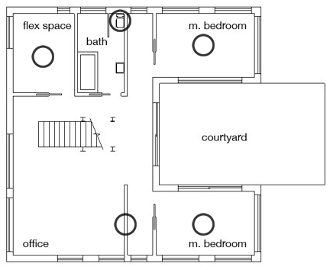
Lower Floor

Slide 27
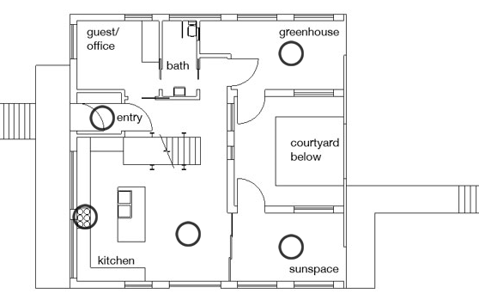
Upper Floor

Slide 28
Predicted Cost
Research and Development Costs
Research and Development Cost | Purpose | Total Cost
Budget | Component purchases for design and testing | $500.00
The predicted cost does not reflect the cost of the motors nor the interface materials for the motors.
Estimate of $300 to $400 for the composting toilet DC motor.
The price for the blind motor is still unspecified

Slide 29
Conclusion
With this wireless sensor network, users can access information about temperature, humidity, light, and occupancy in a room, water level in a container, and power usage via an interface to a central server without directly going to the sensors to read information.
Users are able to control outputs such as motors and light levels wirelessly.
The system itself is power-efficiency and cost effectiveness.
Assist the home owner in reducing energy consumption as well as making the home more energy efficient through automation.

Slide 30

Q & A

Slide 31
Communication protocol (backup)
Frame | Route | Action | Data | End of package
Action | What the sender is going to do
M: Sender wants to send map to the destination.
R: Sender wants to send request to the destination.
D: Sender want to send data to the destination

Slide 32
Communication protocol (backup)
Frame | Route | Action | Data | End of package
Data | Data to send to the destination
Depending on the Action:
Action is M: Data contains the route telling the destination node how to get back the sender.
Action is R: Data contains one byte standing for names of sensors the sender is requesting (H, T, L, O, W, Z).
Action is D:
From sender: Data contains the command from server to control the outputs.
From destination node: Data contains values from sensors.

